Slide 1
Topic: Bivariate Data EQ: How do I compare bivariate Data?

Slide 2
Contents
Glossary or Formula Page
Page
Date
Description
2
3

Slide 3
Tasks
24
7
30
Essential Question
Questions
Notes
Summary
4
5

Slide 4
24
7
30
Date
Bivariate Data
EQ: How do I compare bivariate Data?
What is Bivariate data
Bivariate data is data represented by two variables.
What is the relationship between the two variables?
1. Are the values of one variable related to the values of another variable?
2. Can the values of one variable be used to predict the values of another variable?
5

Slide 5
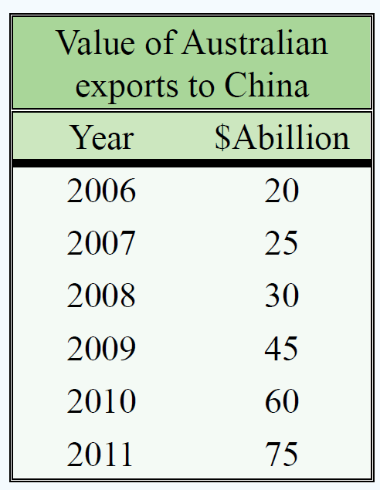
24
7
30
Date
Bivariate Data
EQ: How do I compare bivariate Data?
This is an example of bivariate data. The two variables are Year and $Abillion.
The first column is the independent variable (x axis)
The second column is the dependent variable
(y axis)
5

Slide 6
24
7
30
Date
Bivariate Data
EQ: How do I compare bivariate Data?
This is an example of bivariate data. The two variables are Year and $Abillion.
The first column is the independent variable (x axis)
The second column is the dependent variable
(y axis)
Is there a relationship between Year and the value of exports to China?
Can a prediction be made about the value of exports to China in 2012?
5

Slide 7
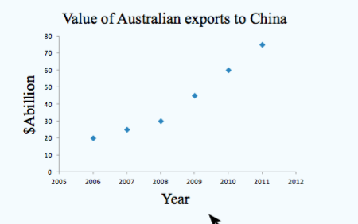
24
7
30
Date
Bivariate Data
EQ: How do I compare bivariate Data?
What is a Scatterplot?
Scatterplots give a visual representation of how the values of one variable are related to the values of another variable.
Value of Australian exports to China
Year | $Abillion
2006 | 20
2007 | 25
2008 | 30
2009 | 45
2010 | 60
2011 | 75
The independent variable, Year, is placed on the x-axis.
The dependent ($) , Year, is placed on the y-axis.
5

Slide 8
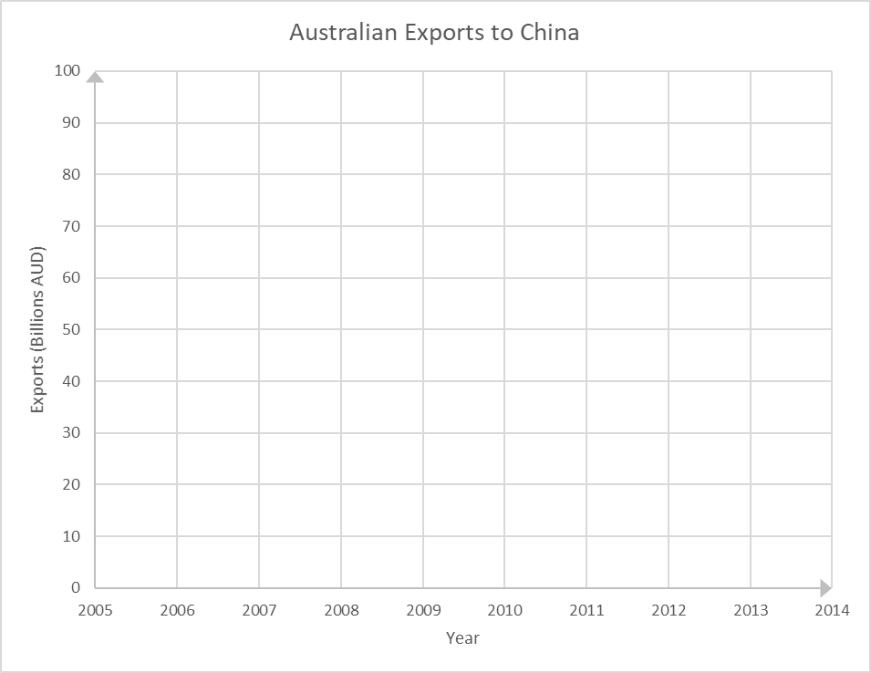
24
7
30
Date
Bivariate Data
EQ: How do I compare bivariate Data?
5
Notes:
Add the points in, moving through the x axis, then y axis for each point, modelling the process of creating the scatter plot

Slide 9
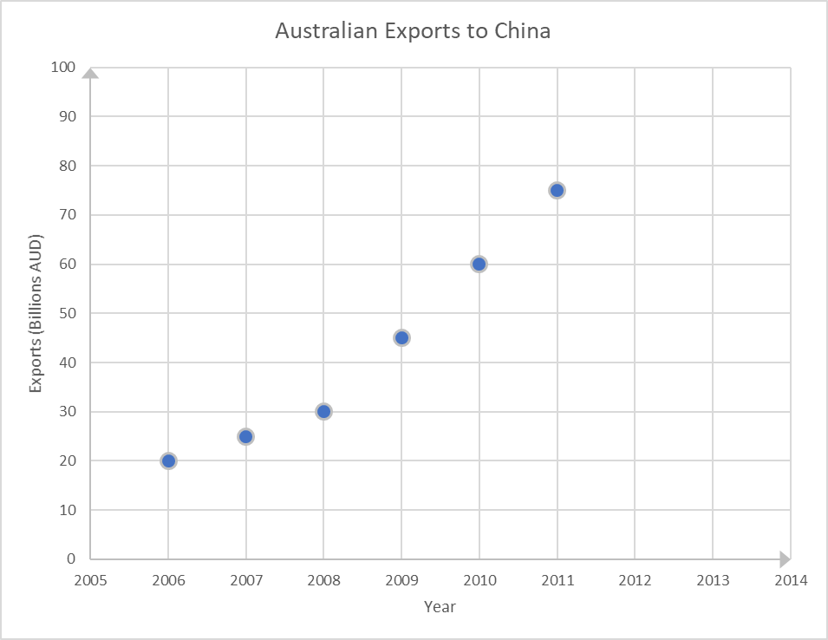
24
7
30
Date
Bivariate Data
EQ: How do I compare bivariate Data?
5

Slide 10
24
7
30
Date
Bivariate Data
EQ: How do I compare bivariate Data?
Title
Y axis labelled
X axis labelled
Scale on the x axis appropriate
Scale on the y axis appropriate
5

Slide 11
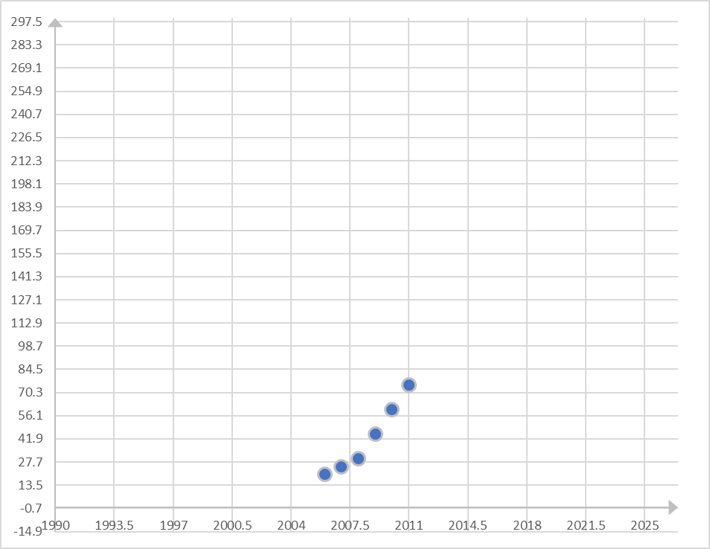
24
7
30
Date
Bivariate Data
EQ: How do I compare bivariate Data?
Exact same data, but impossible to understand what is going on.
5

Slide 12
In summary
We often want to know if there is a relationship between the items in two different data sets. Examples of this are:
Is there a relationship between children’s ages and their heights?
Is there a relationship between people’s heights and weights?
Is there a relationship between students’ marks in an English examination and their marks in a mathematics examination?
What do you think?
Notes:
In each of the above, two pieces of information are to be collected from each person in the investigation and then the two data sets are to be compared. When two pieces of information are collected from each subject in an investigation, we are then concerned with bivariate data.

Slide 13
Notes Review
24, 7 ,30
Date
Title
Essential question
Notes complete
Notes complete with colour and diagrams
Questions completed
Contents page filed in
Formula page filled in

Slide 14
Homework
Review your notes and write a summary answering the essential question.

